Slide 1
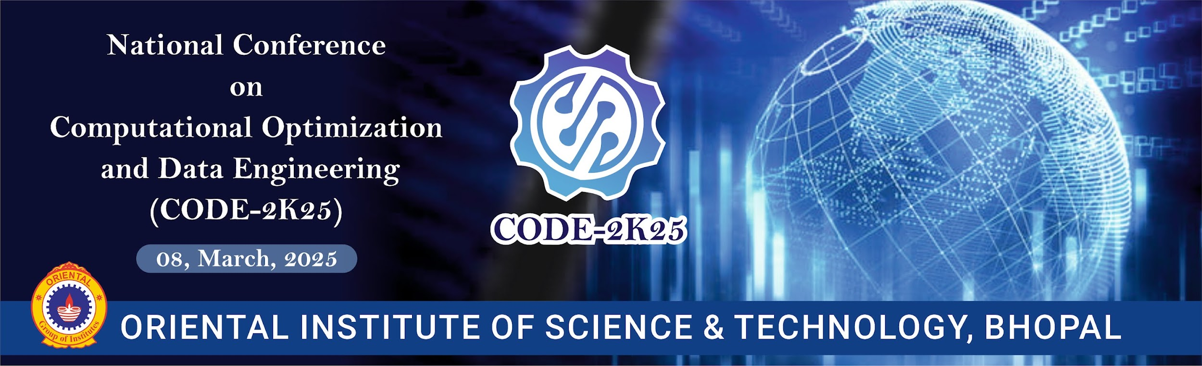
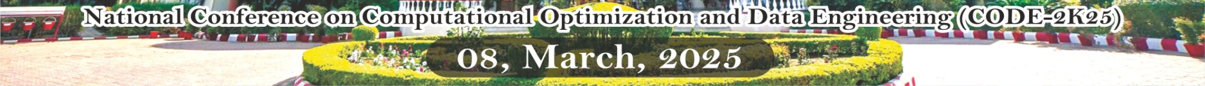
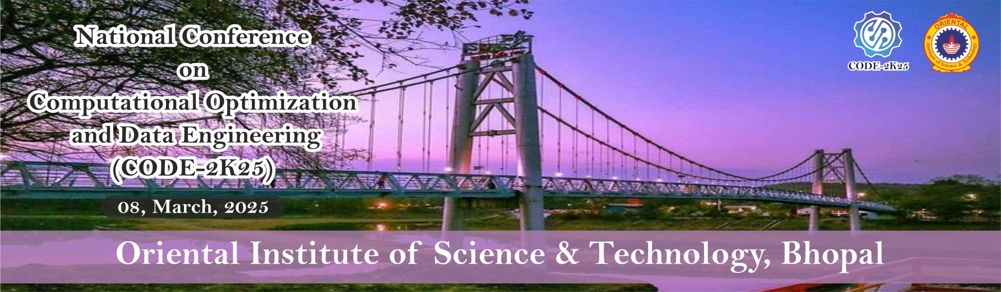

Large Scale Synthetic-Data-Generation-for-Computer-Vision-AI-ML
Abhishek Verma (Author)
Cs-Aiml OIST-RGPV
Bhopal, India
0105AL221012@oriental.ac.in
Atharv Jharbade(member)
Cs-Aiml OIST-RGPV
Bhopal, India
0105AL221044@oriental.ac.in
Divyansh Kande(member)
Cs-Aiml OIST-RGPV
Bhopal, India
0105AL221069@oriental.ac.in
Akshay Deshmukh (member)
Cs-Aiml OIST-RGPV
Bhopal, India
0105AL221022@oriental.ac.in
Code-Conference / Code 2K25

Slide 2
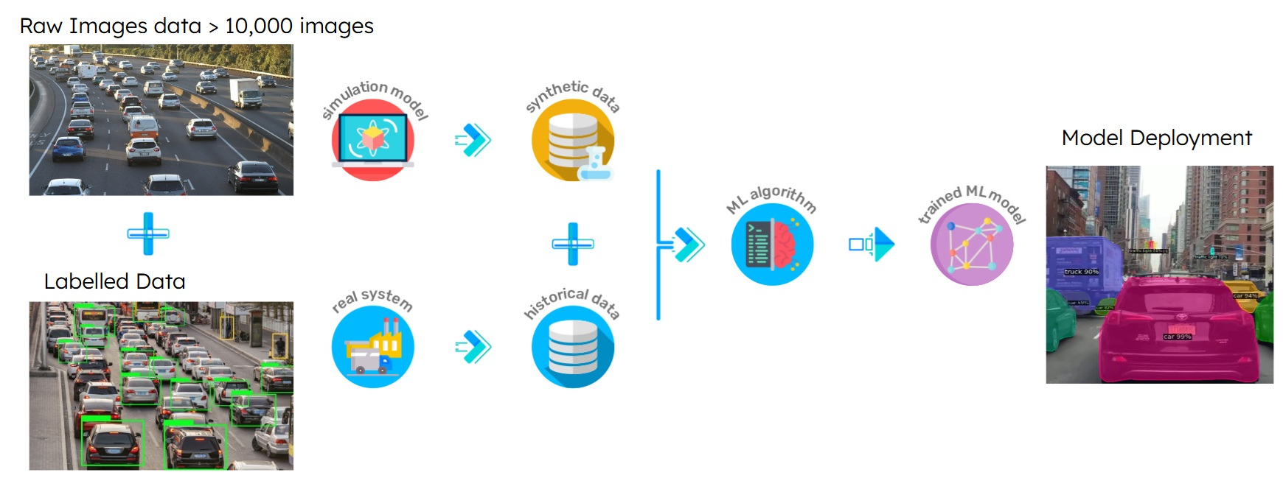
What is Synthetic data generation ?
Research PPT
Code-Conference / Code 2K25
1
Large-scale synthetic data generation involves creating a huge numbers of data like images, sound text, statistical data etc using labelling and designing softwares or by using another ai models. but in this research this synthetic data generation means of creating the huge amount of realistic, computer-generated images using 3D software like Blender to train AI models.
Computer vision Ai model Training approach:-

Slide 3
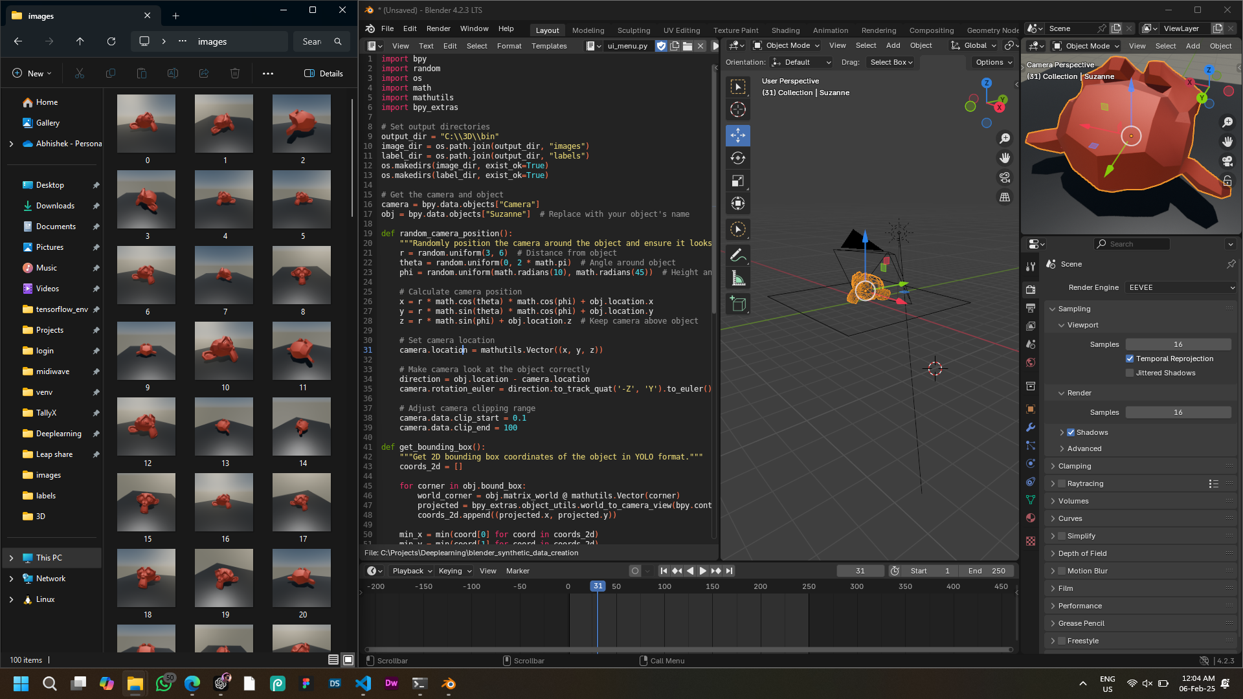
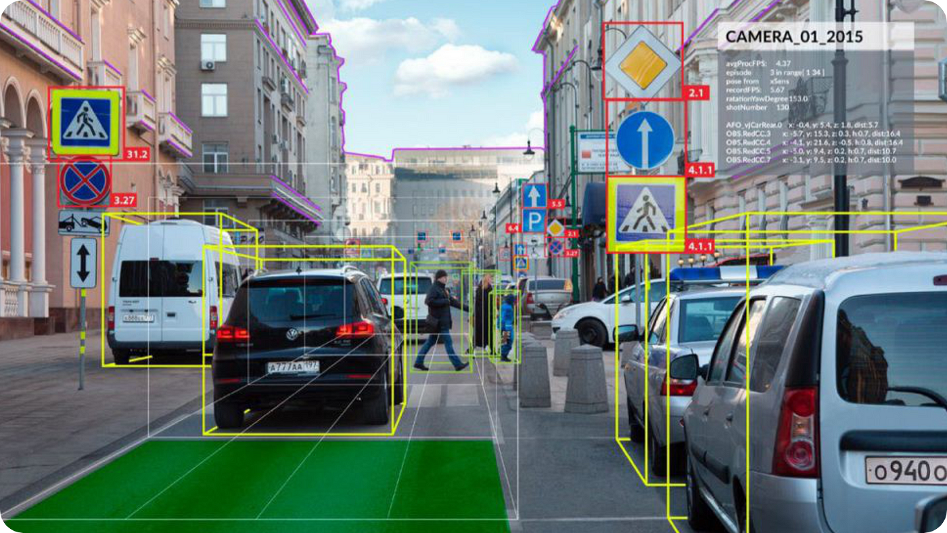
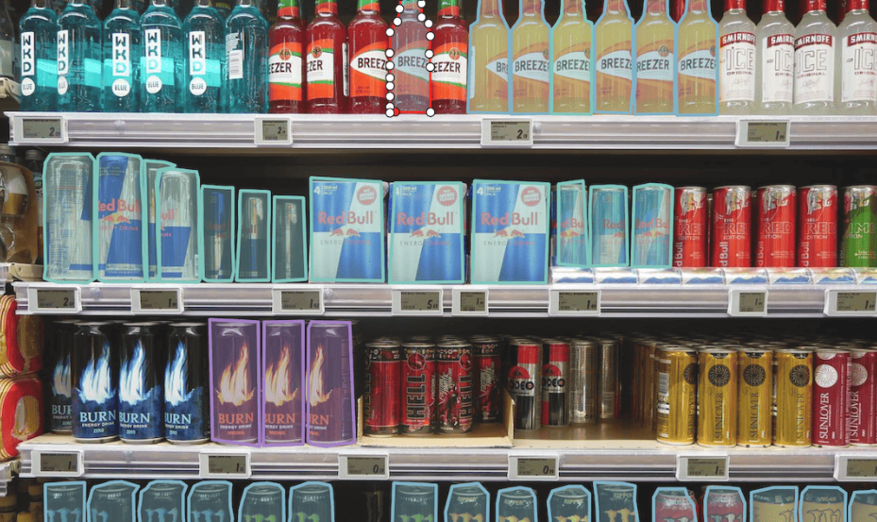
Need of Synthetic data generation for computer vision
Deep learning outperforms traditional ML by mimicking the human brain but needs vast labeled data. Synthetic data solves this by simulating environments, improving accuracy, and enhancing deep learning model generalization for real-time image tasks.
Here are some common problems arrived in traditional image data preparation.
Research PPT
PROBLEMS
SOLUTION
Code-Conference / Code 2K25
2
Generate millions of synthetic images data using Open Source 3D software like Blender , to train Ai models efficiently.
1.Image data Scarcity and variations
2. 3D Depth understanding

Slide 4
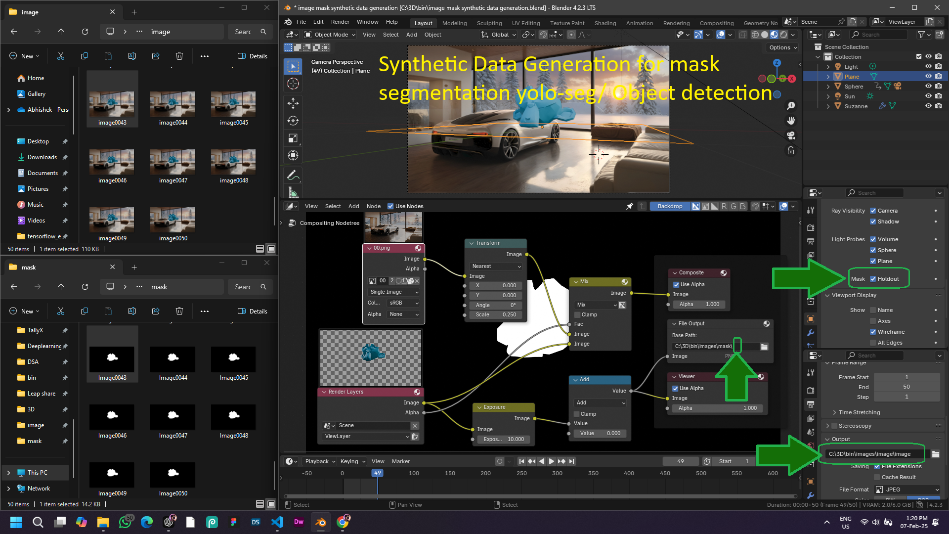
Research PPT
Code-Conference / Code 2K25
3
Blender 4.2 Snapshot for creating masked image data of 3d model

Slide 5
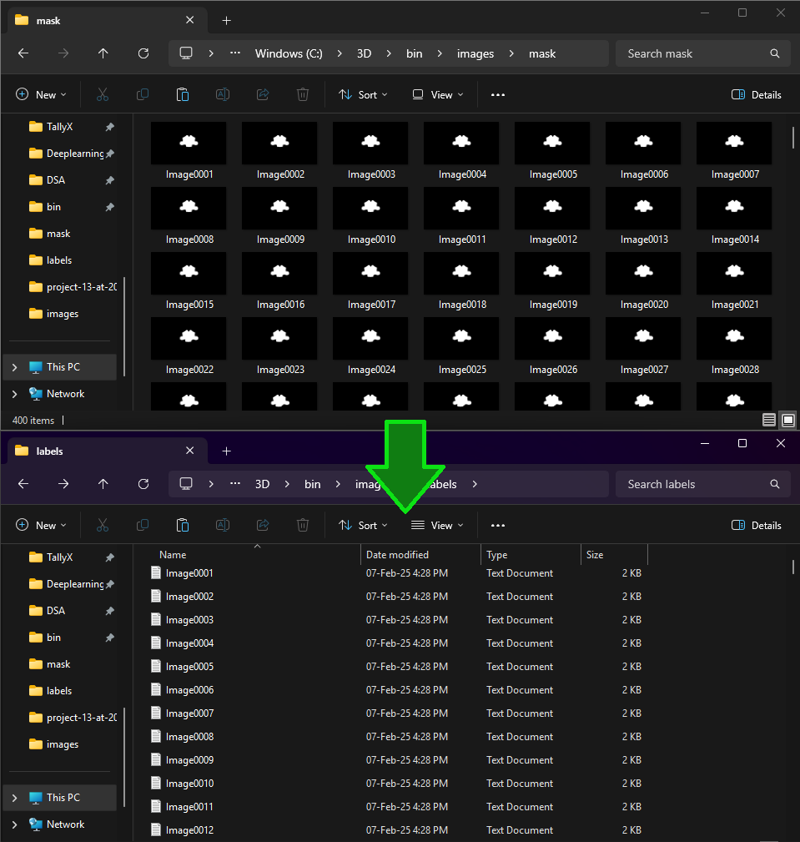
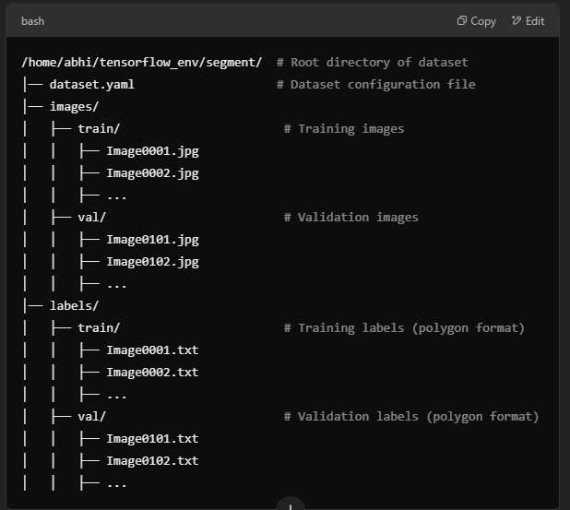

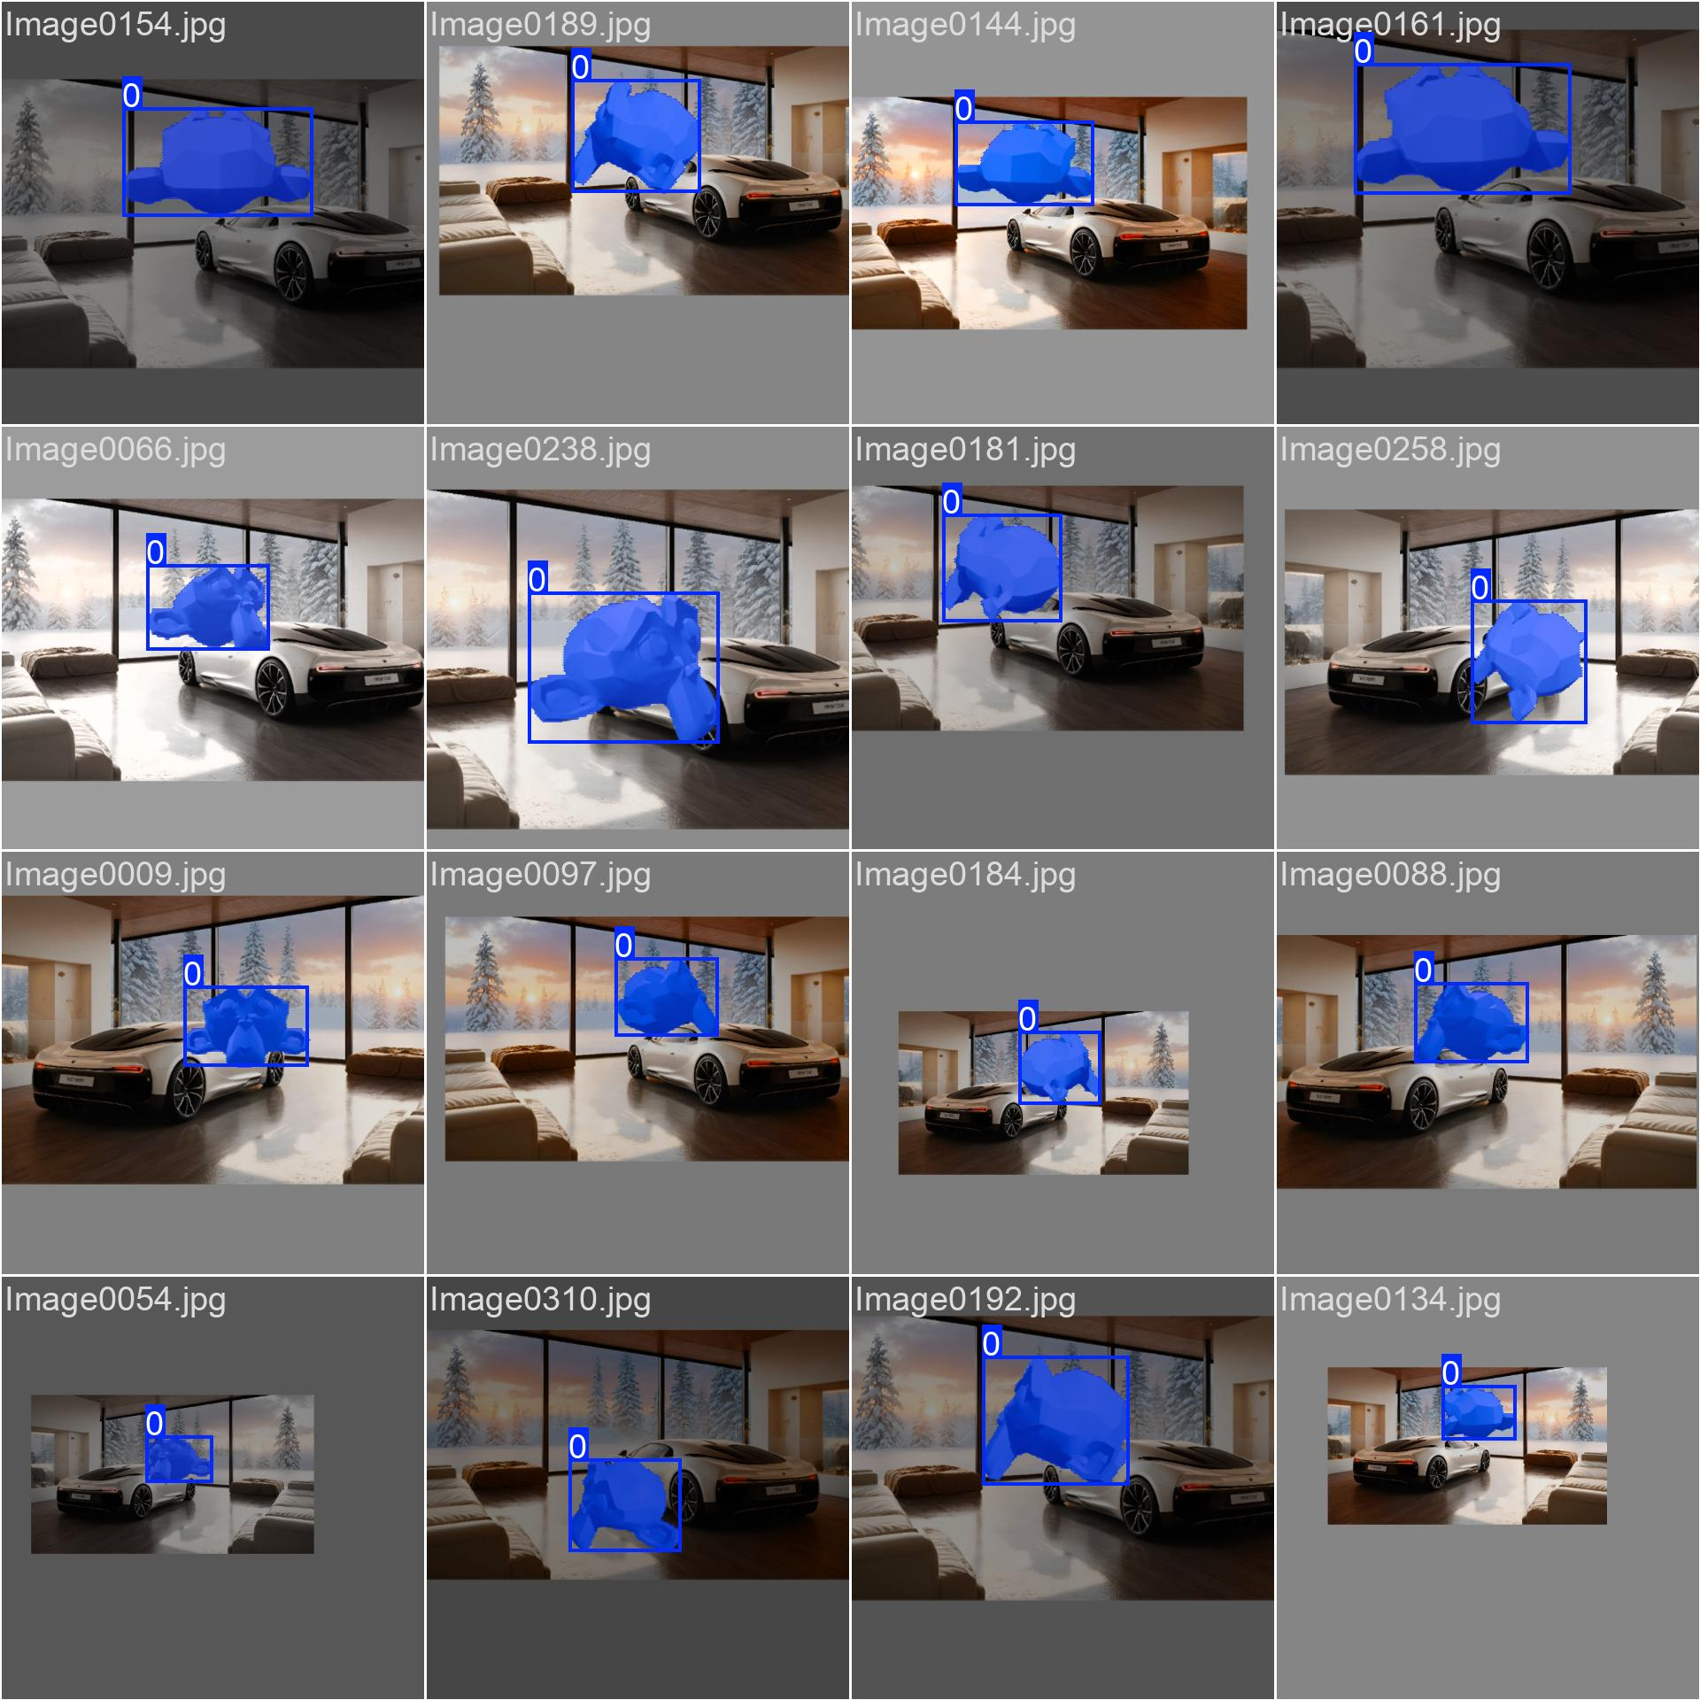
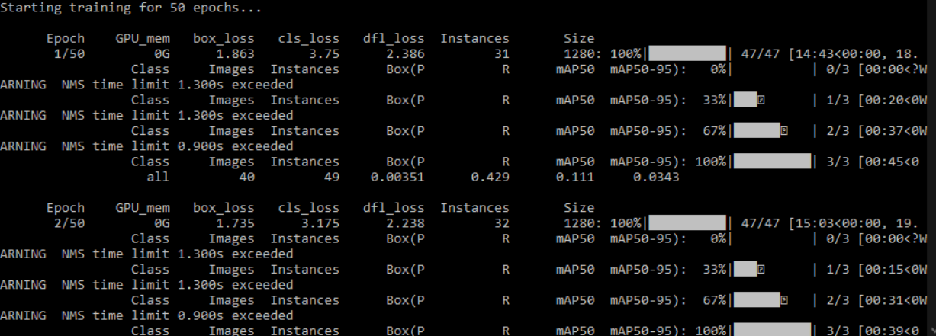

Research implementation process
Research PPT
Code-Conference / Code 2K25
4
1.Creation of photorealistic rendered images and masked images data from 3d model in Blender
2.Convert masked images to polygons labelled data using our python program
3. Move the images data in the valid directory structure for training the Yolo v8-segmentation model
5. Evaluate and Deploy the model
4. Train the ML Model using these datasets

Slide 6
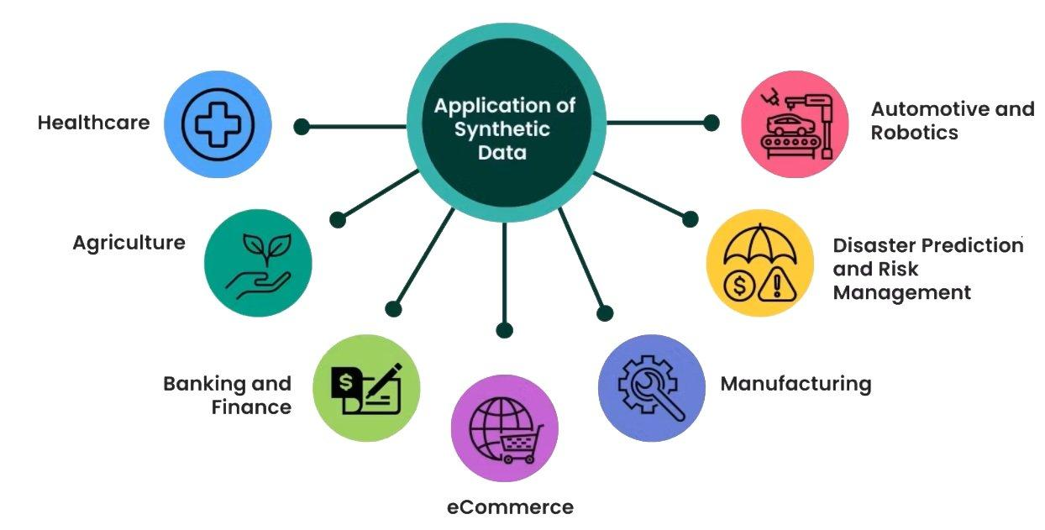
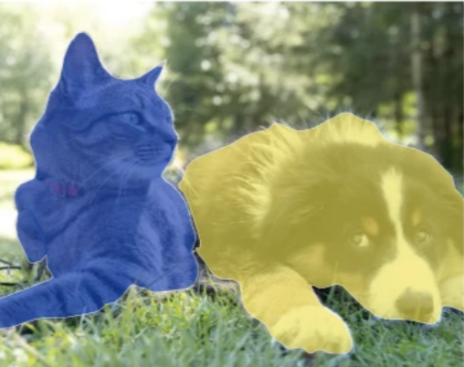
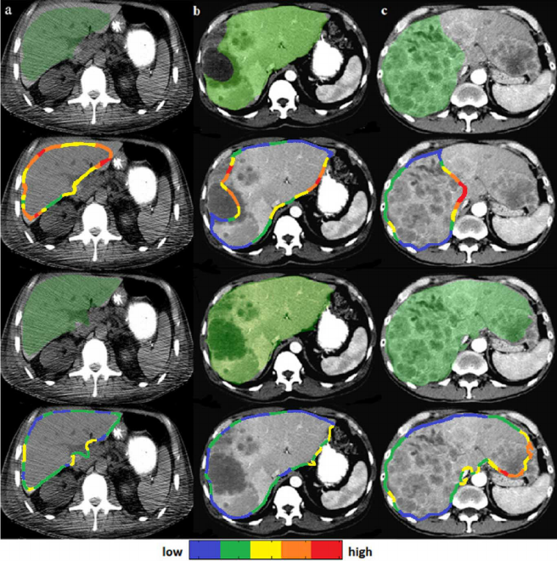
Future applications:
& Infinite possibilities
1.Autonomous Vehicles: we canTrain self-driving cars for object detection and road segmentation.
2.Medical Imaging: we can generate similar labeled medical scans for AI-driven diagnostics.
3.Augmented Reality (AR) & Virtual Reality (VR):
Security & Surveillance
4.Agriculture: we can generate synthetic data tor ai model that Identify crop diseases using AI-powered image segmentation.
5..Robotics
6.Gaming & Animations
7.HealthCare
8.Manufacturing etc..
Research PPT
Code-Conference / Code 2K25
5
Autonomous Driving
Robotics and vision
Virtual Reality
Healthcare and medicals

Slide 7
Thank You
Oist, Bhopal
Code-Conference / Code 2K25

